Slide 1
CARDIOVASCULAR DISEASE ANALYSIS AND ITS PREDICTION ​
BY:PARTEEK SAINI
11801116
3CE-5

Slide 2
CONTENTS
INTRODUCTION TO MACHINE LEARNING​
APPLICATIONS OF MACHINE LEARNING​
MAJOR TASK OF DATA PRE - PROCESSING​
TYPES OF MACHINE LEARNING ALGORITHMS
PROJECT​
REFERENCES

Slide 3

INTRODUCTION TO MACHINE LEARNING

Slide 4

MACHINE LEARNING
Machine Learning is an application of artificial intelligence (AI) that provides system the ability to automatically learn and improvise from experience without being explicitly programmed.

Slide 5
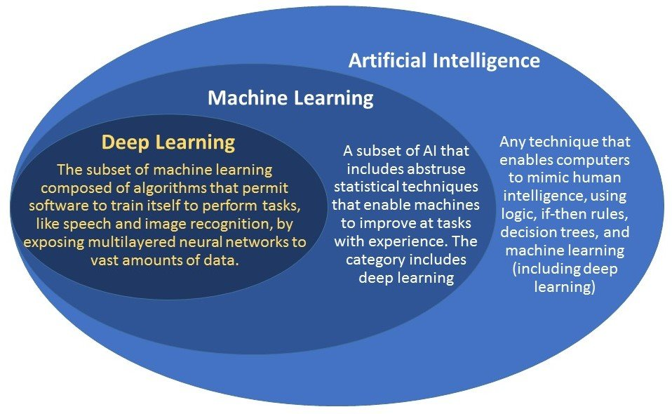
RELATION BETWEEN ARTIFICIAL INTELLIGENCE, MACHINE LEARNING AND DEEP LEARNING

Slide 6
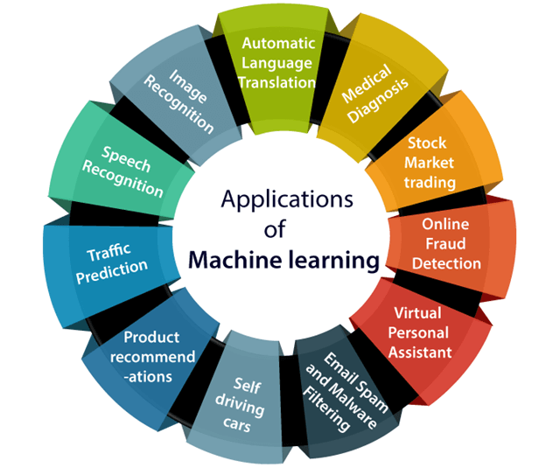

Slide 7
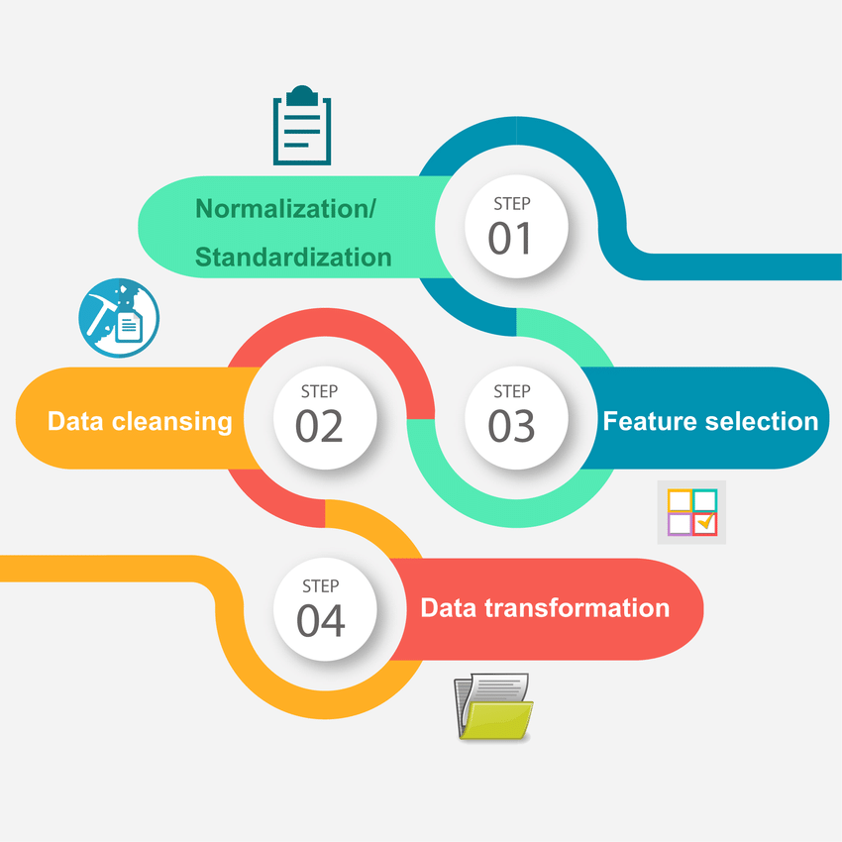
MAJOR TASKS OF DATA PRE-PROCESSING

Slide 8
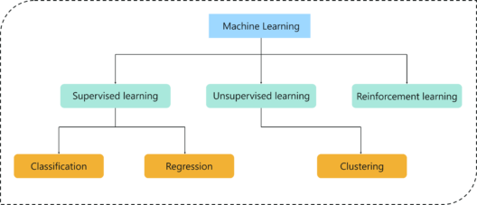
TYPES OF MACHINE LEARNING ALGORITHMS

Slide 9
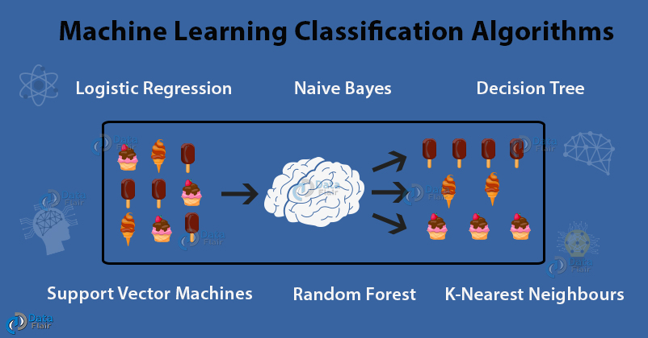

Slide 10
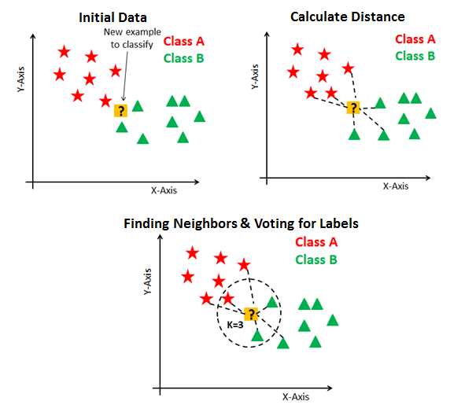
K-NEARSET NEIGHBOUR (K-NN) CLASSIFICATION

Slide 11
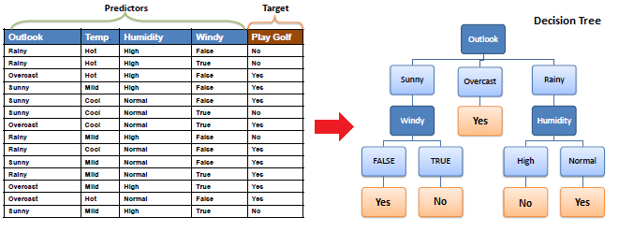
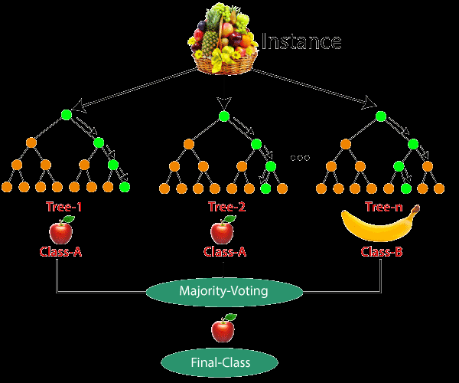
DECISION TREE CLASSIFIC-ATION
RANDOM FOREST CLASSIFICATION

Slide 12
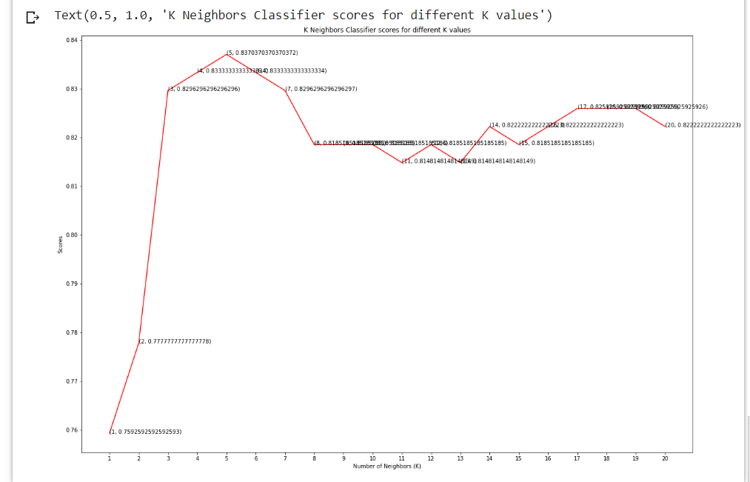
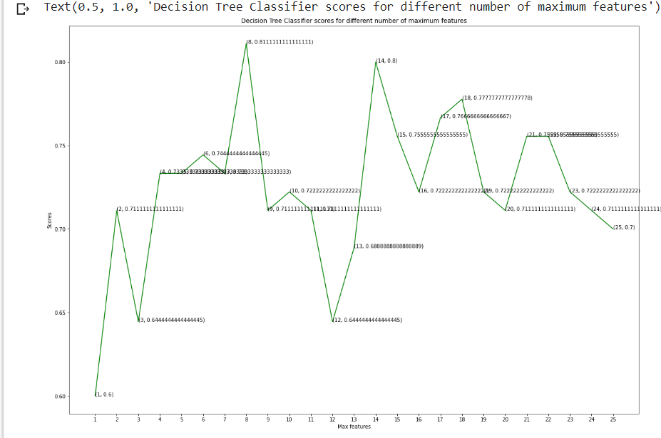
PROJECT :
CARDIOVASCULAR DISEASE ANALYSIS AND ITS PREDICTION

Slide 13
IMPORTING OF LIBRARIES AND ML ALGORITHMS
 | # Basic
 | import numpy as np
 | import pandas as pd
 | import matplotlib.pyplot as plt
 | from matplotlib import rcParams
 | from matplotlib.cm import rainbow
 | %matplotlib inline
 | import warnings
 | warnings.filterwarnings('ignore')
 | # Other libraries
 | from sklearn.model_selection import train_test_split
 | from sklearn.preprocessing import StandardScaler
 | # Machine Learning
 | from sklearn.neighbors import KNeighborsClassifier
 | from sklearn.tree import DecisionTreeClassifier
 | from sklearn.ensemble import RandomForestClassifier

Slide 14
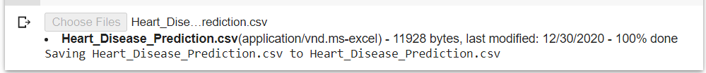
IMPORTING OF DATSET
from google.colab import files
uploaded = files.upload()
import io
df = pd.read_csv(io.BytesIO(uploaded['Heart_Disease_Prediction.csv']))

Slide 15
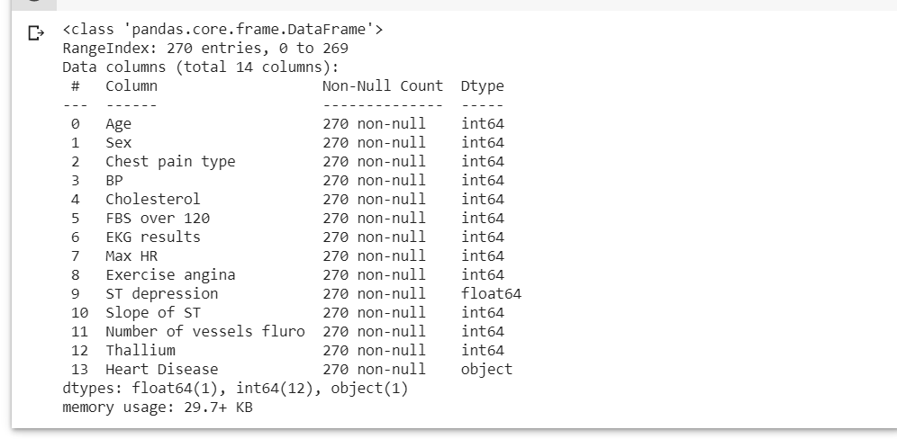
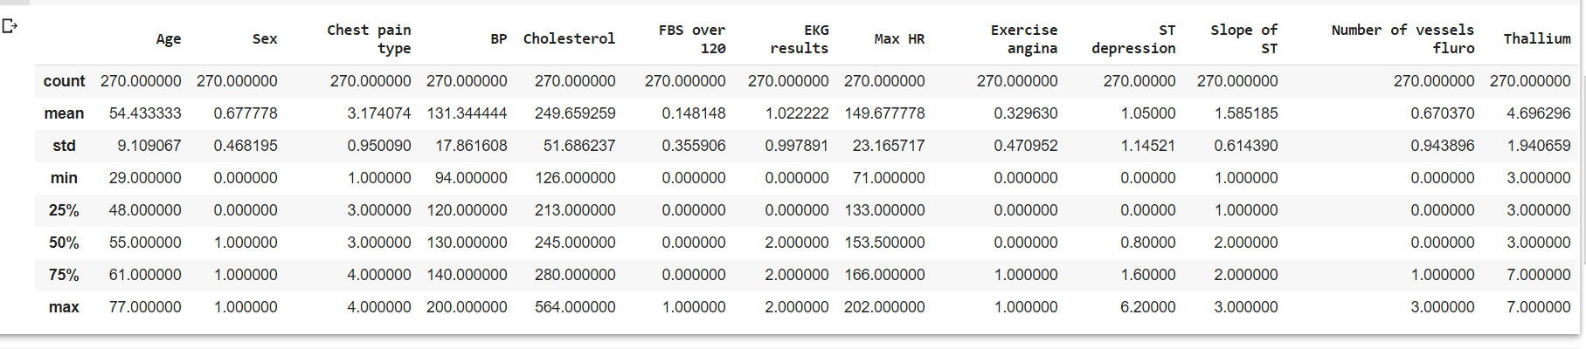
BASIC INFORMATION ABOUT DATASET
df.info()
df.describe()

Slide 16
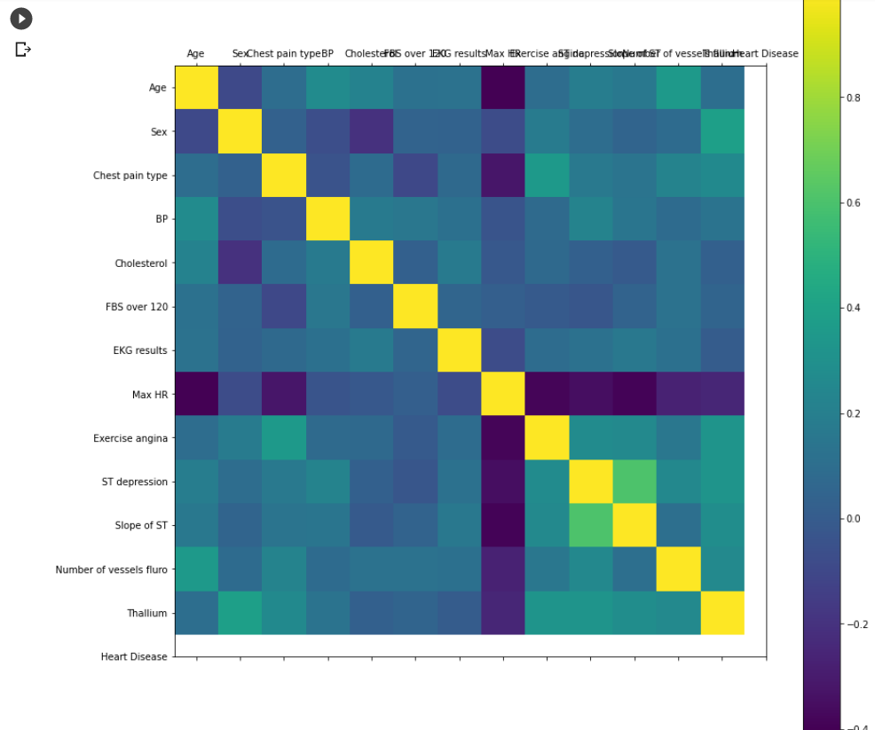
CO-RELATIONAL MATRIX
rcParams['figure.figsize']=20,14
plt.matshow(df.corr())
plt.yticks(np.arange
(df.shape[1]), df.columns)
plt.xticks(np.arange
(df.shape[1]), df.columns)
plt.colorbar()

Slide 17
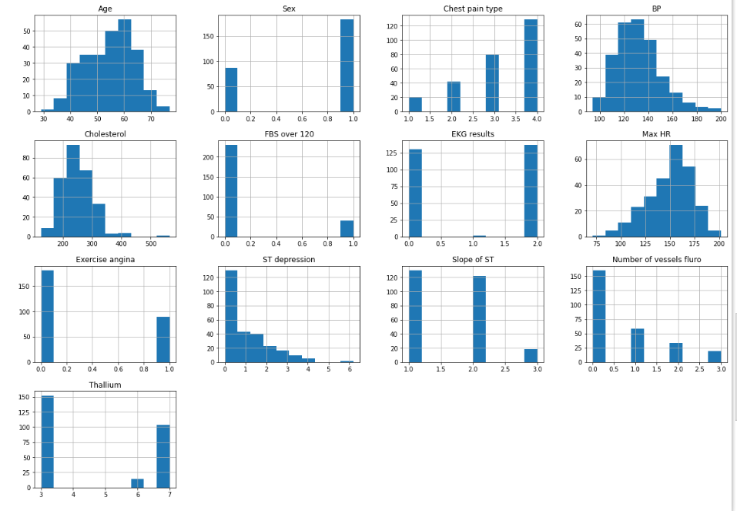
HISTOGRAM
df.hist()

Slide 18
DATA PROCESSING
dataset = pd.get_dummies(df, columns = ['Sex','Chest pain type','FBS over 120','EKG results','Exercise angina','Slope of ST','Thallium'])
from sklearn.model_selection import train_test_split
from sklearn.preprocessing import StandardScaler
standardscaler = StandardScaler()
coloumns_to_scale = ['Age','BP','Cholesterol','Max HR','ST depression']
dataset[coloumns_to_scale] = standardscaler.fit_transform(dataset[coloumns_to_scale])

Slide 19
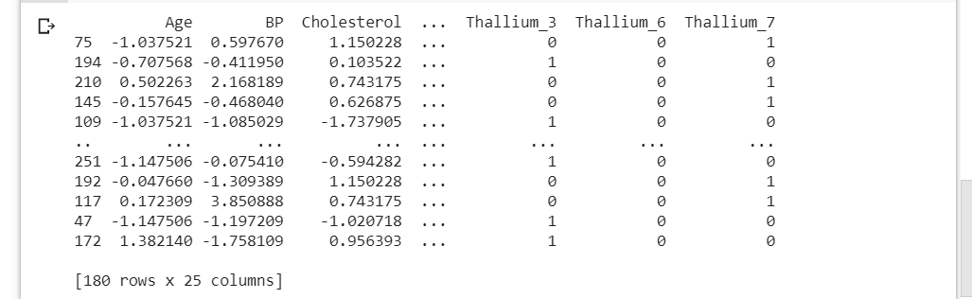
MACHINE LEARNING
y = dataset['Heart Disease']
X = dataset.drop(['Heart Disease'], axis = 1)
X_train,X_test,y_train,y_test = train_test_split(X, y, test_size = 0.33, random_state = 0)
print(X_train)
print(y_train)
print(X_test)
print(y_test)

Slide 20
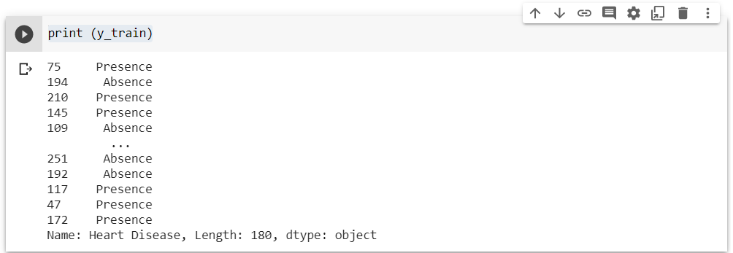
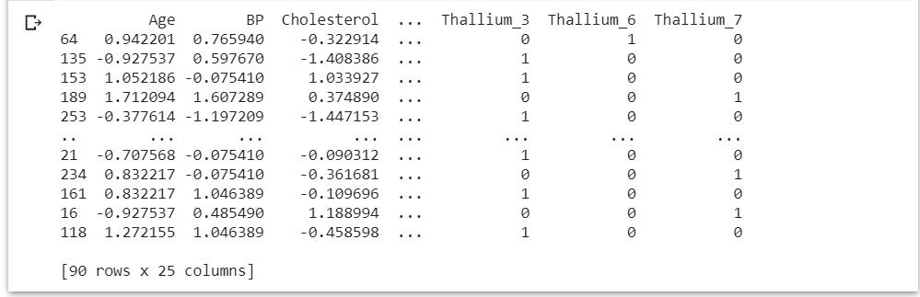
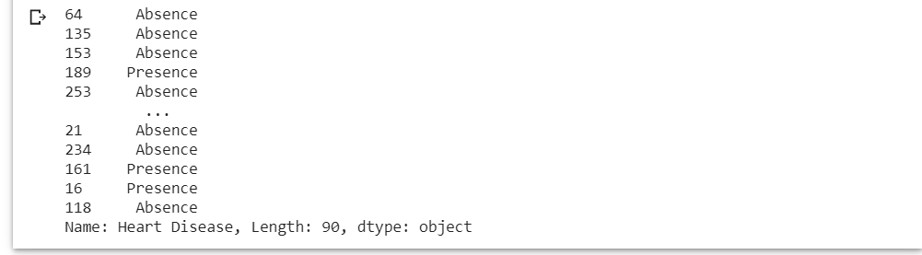
print(y_train)
print(X_test)
print(y_test)

Slide 21
K-NEIGHBOR CLASSIFIER
from sklearn.model_selection import cross_val_score
knn_scores = []
for k in range(1,21):
knn_classifier = KNeighborsClassifier(n_neighbors = k)
score=cross_val_score(knn_classifier,X,y,cv=10)
knn_scores.append(score.mean())

Slide 22
LINE GRAPH OF NO OF NEIGHBOURS AND TEST SCORE ACHIEVED IN EACH CASE
plt.plot([k for k in range(1, 21)], knn_scores, color = 'red')
for i in range(1,21):
plt.text(i, knn_scores[i-1], (i, knn_scores[i-1]))
plt.xticks([i for i in range(1, 21)])
plt.xlabel('Number of Neighbors (K)')
plt.ylabel('Scores')
plt.title('K Neighbors Classifier
scores for different K values')

Slide 23
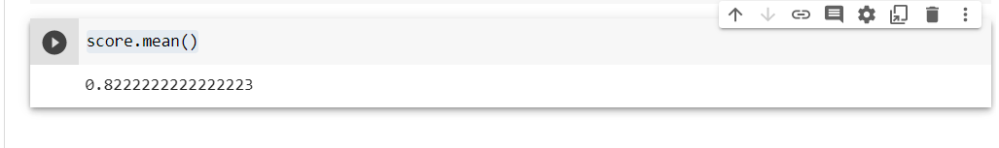
knn_classifier =KNeighborsClassifier(n_neighbors=12)
score=cross_val_score(knn_classifier,X,y,cv=10)
score.mean()

Slide 24
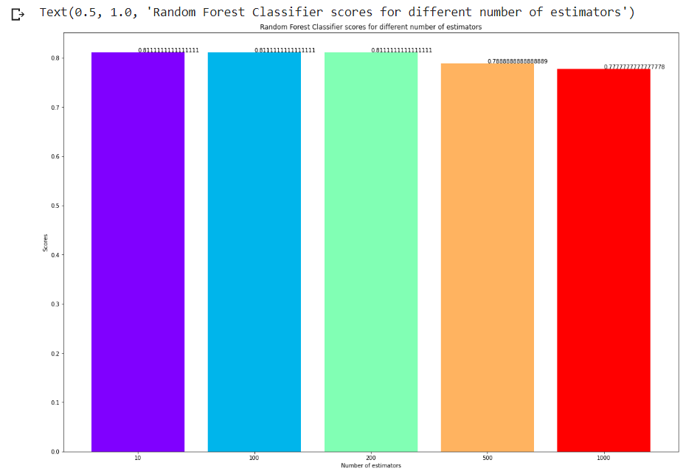

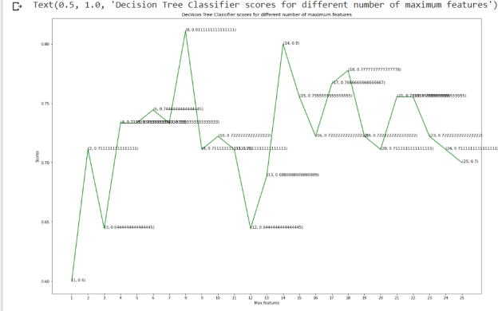
COMPARISON
ALGORITHMS | K-NN CLASSIFIER | RANDOM FOREST CLASSIFIER | DECISION TREE CLASSIFIER
MEAN VLAUE | 82% | 81% | 74%

Slide 25
BIBLIOGRAPHY
https://scikit-learn.org/
https://www.google.com/
https://colab.research.google.com/

Slide 26


